Slide 1
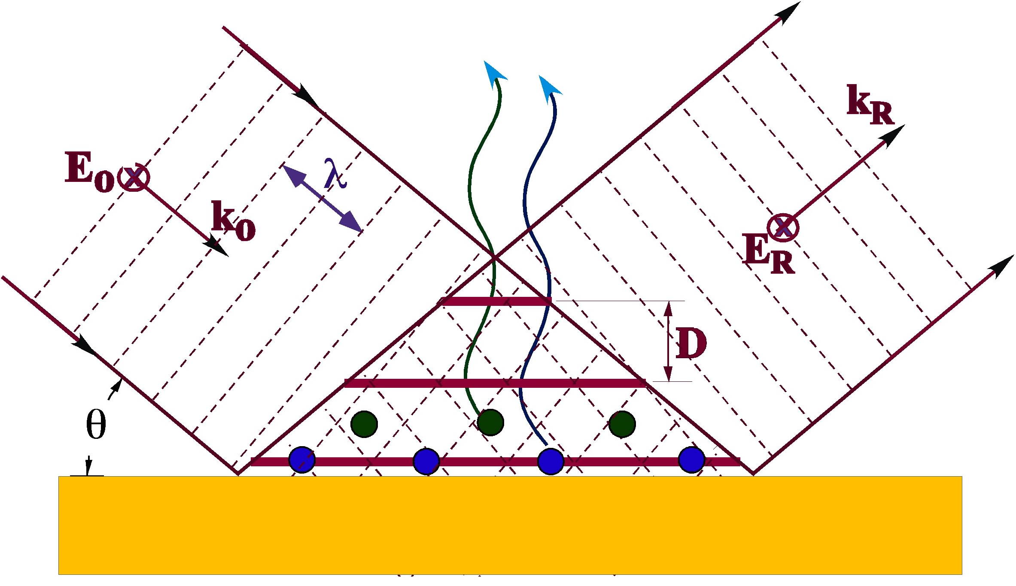
X-Ray Materials Science
Michael Bedzyk
Materials Research Science and Engineering Center (MRSEC)
Institute for Catalysis in Energy Processes (ICEP)
Center for Electrical Energy Storage (CEES)
Synchrotron Research Center (SRC)
Argonne Northwestern Solar Energy Research Center (ANSER)
Center for Hierarchical Materials Design (CHiMaD )
X-rays: APS, NU X-ray Lab
Funding: NSF, DoE, AirForce, NIST

Slide 2
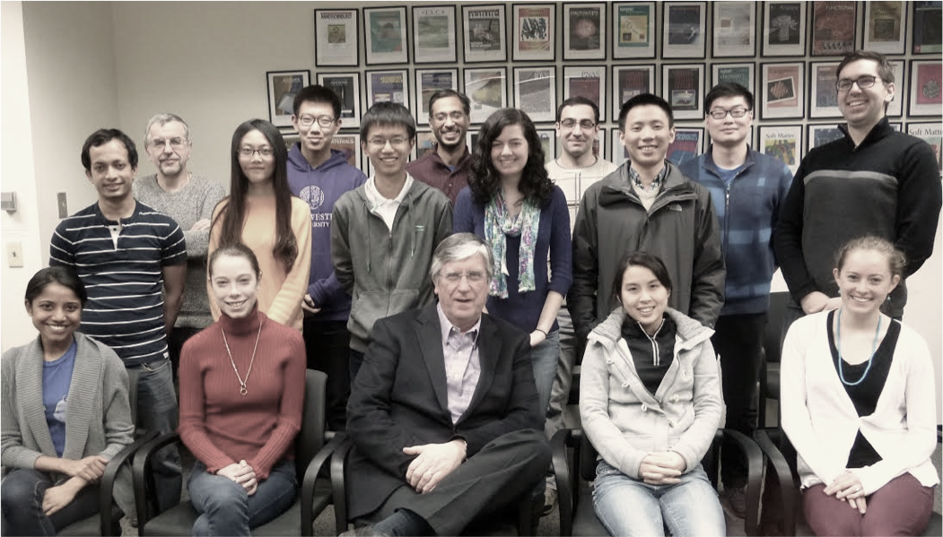
Bedzyk group:
Group breakdown: 2 postdocs, 10 PhD graduate students:
6 MSE,
3 Applied Physics
1 Physics & Astronomy
3 grads finishing next year

Slide 3
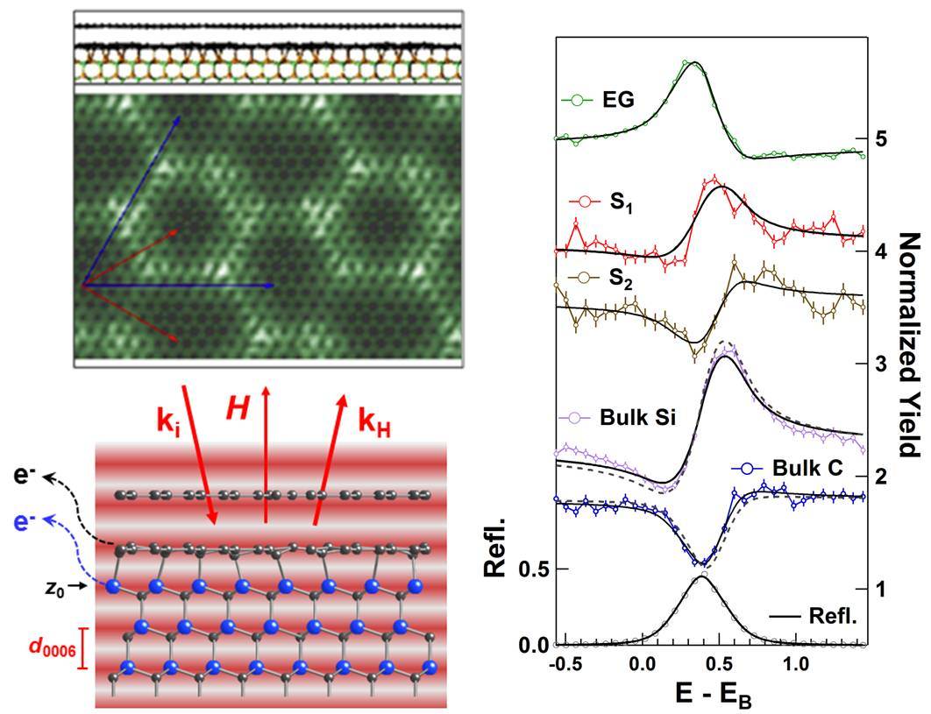
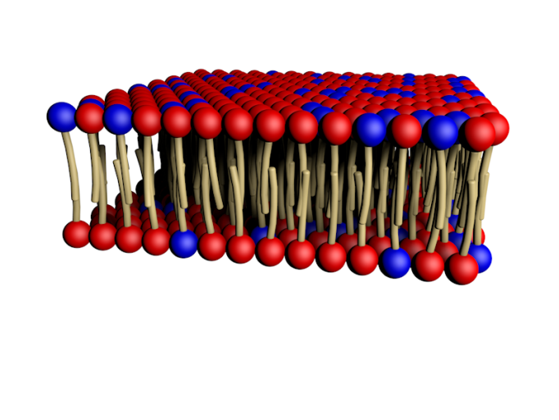
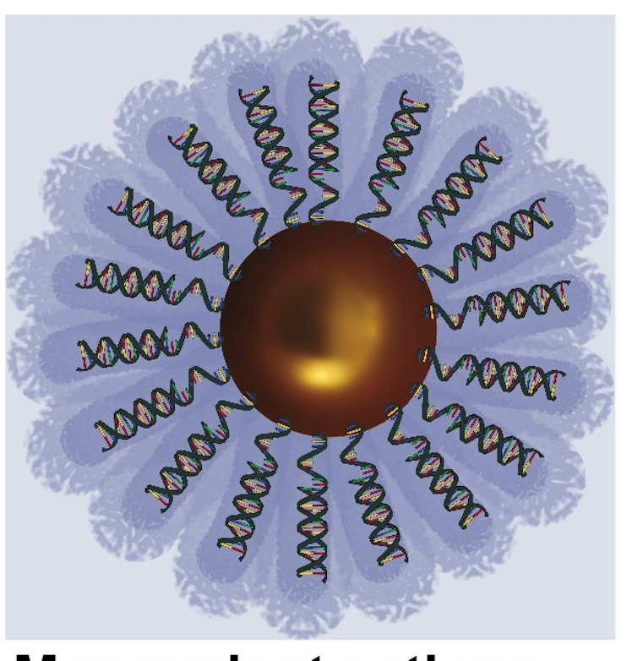
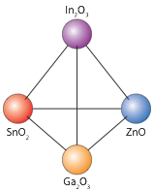
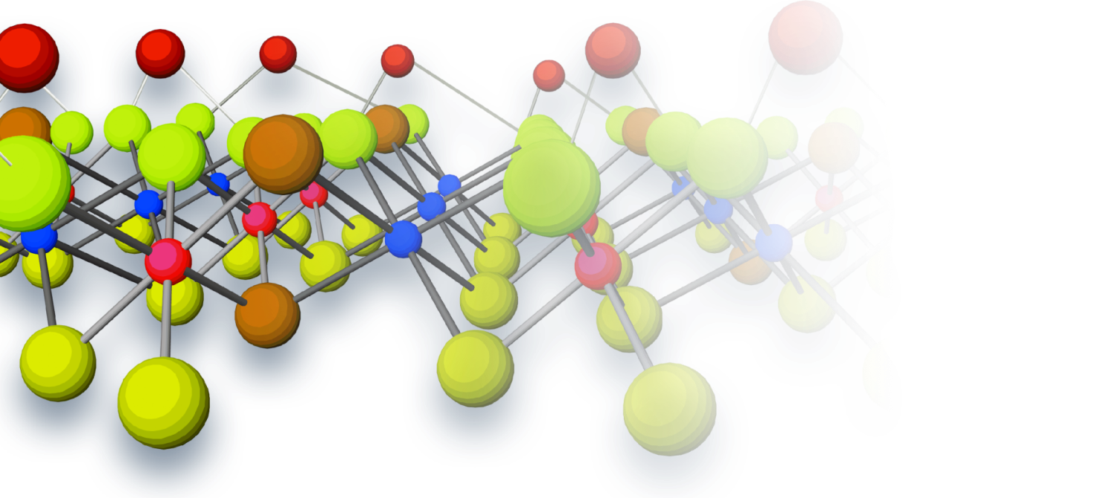
Research Group Theme: X-Ray Interface Science
Organic/Inorganic Hybrid Interfaces
2D Materials
Oxide Supported Catalysts
Super Alloy Films MGI
Amorphous Oxide Semiconductors
Electrode-Electrolyte Interface
Molecular Assembly (Membranes & Fibers)
DNA-Nanoparticle Assembly
SiO₂
Si

Slide 4
Some X-ray Basics: Wave Property ➔Structural Info λ = 0.1 to 10 Å wavelength E-M radiation X-rays scatter coherently from electrons Particle Property ➔Compositional Info E_{ϒ} = 1 to 100 keV energy Photo effect: Inner shell (K, L) ionization XRF : Decay of excited ion to ground state by characteristic XRF emission

Slide 5

X-ray Vision
Advantage:
Weak interaction with matter
High penetrating power
→In situ analysis
→ Buried structures
Atomic-scale resolution
Problem:
Weak interaction with matter
→ weak signal
Need very intense X-ray source

Slide 6
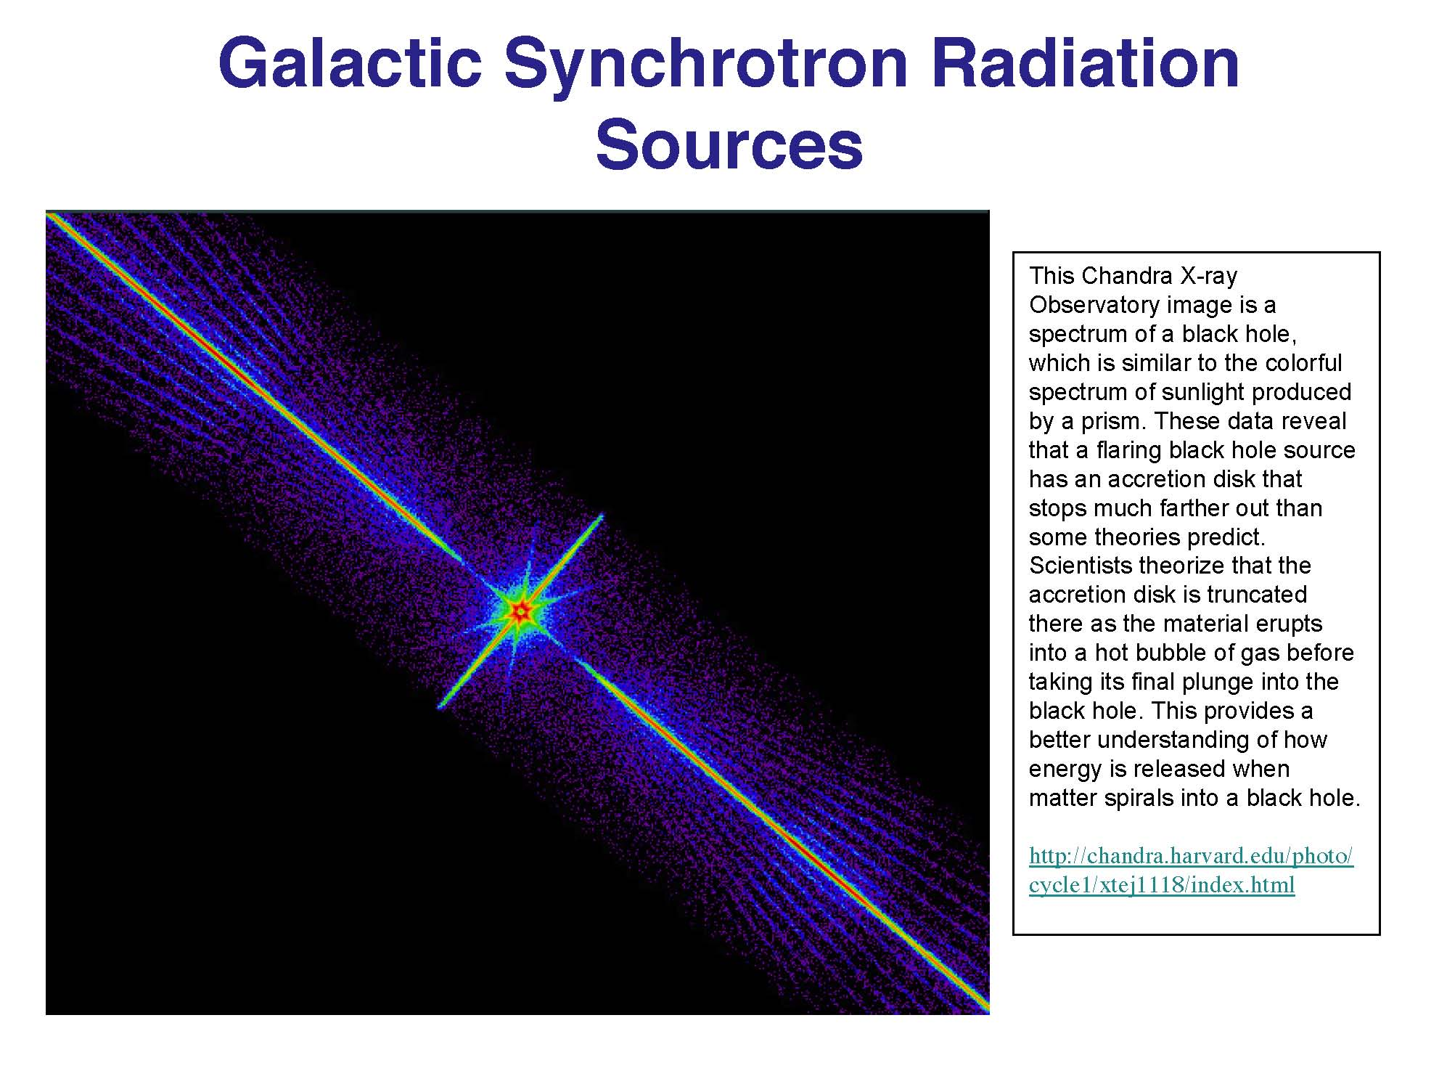

Slide 7
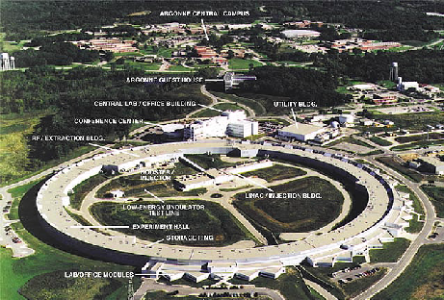
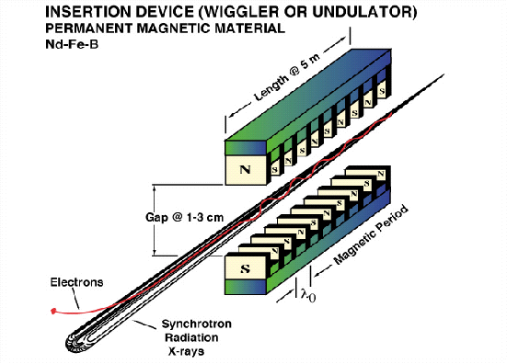
Brightest X-ray Source in Western Hemisphere
= Advanced Photon Source
Undulator Device
relativistic electrons pass thru periodic magnetic array

Slide 8
X-ray Scattering Diffractometer at Advanced Photon Source
Grazing Incidence
Surface Sensitivity

Slide 9


Argonne National Laboratory
Funded by US Dept. of Energy Lab
NU
NU-ANL Carpool
ORD
ANL

Slide 10
What a new student in the Bedzyk group might expect to be involved with while pursuing their PhD
Gain an expertise with general x-ray techniques and experimental design
Learn fundamental materials science/ chemistry/ physics/ biology relevant to the systems they are studying (interdisciplinary research)
Take measurements at the Advanced Photon Source
Understand atomic-scale structure and how it correlates with desirable materials properties

Slide 11
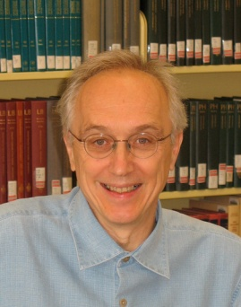
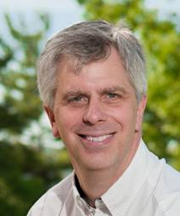
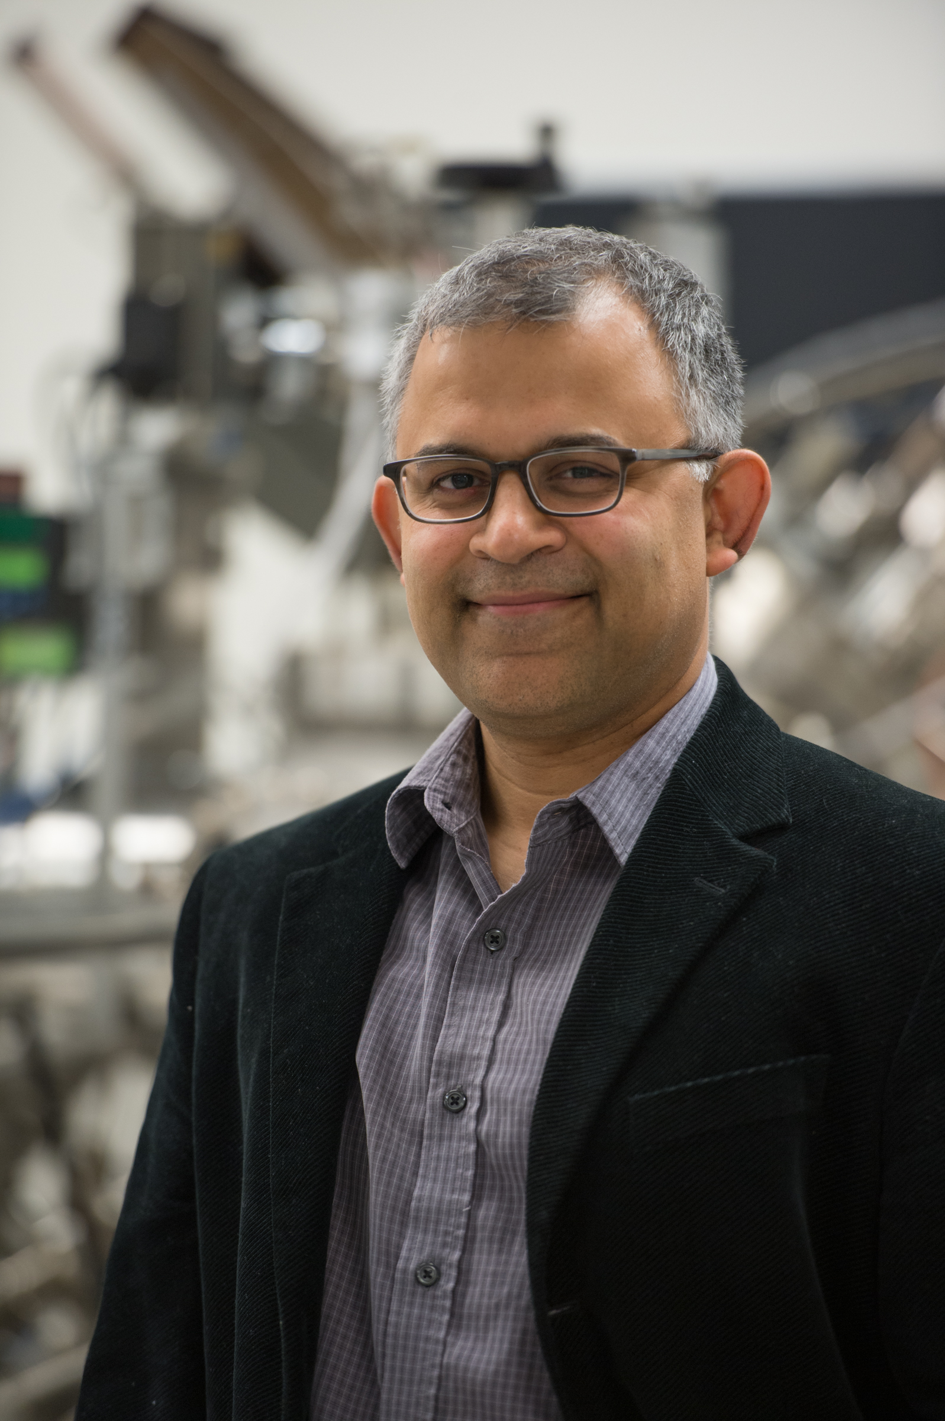
Argonne collaborative projects
looking for 5 new grad students
3 with Nenad Markovic, MSD, JCESR
Electrode/Electrolyte Interface Structure & Properties
1 with Paul Fenter, CSE
Water-Solid Interactions
1 with Anand Bhattacharya, MSD & CNM
Digital Synthesis: Tailoring novel properties in complex oxides

Slide 12
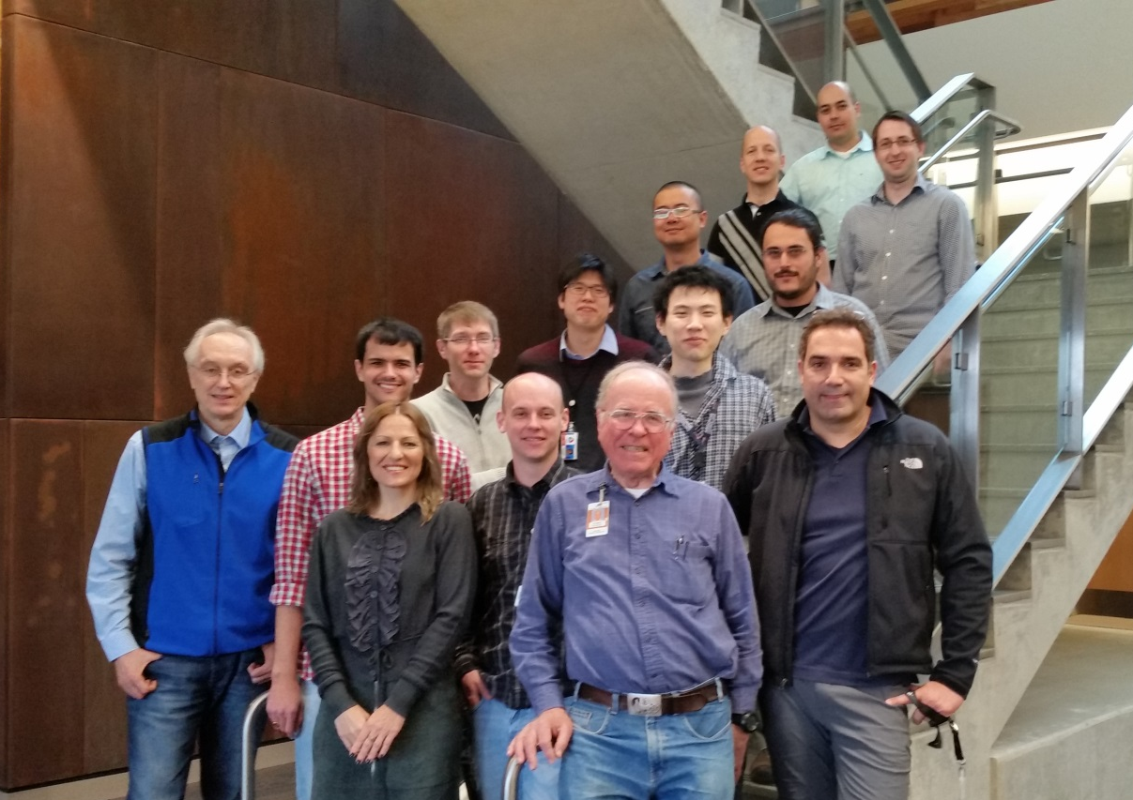
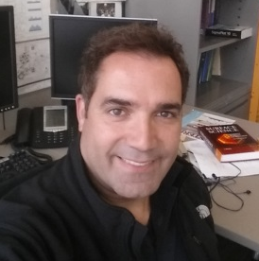
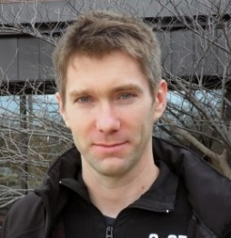
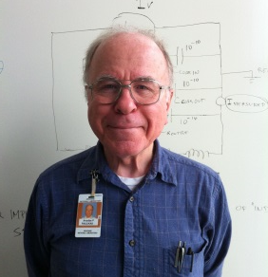
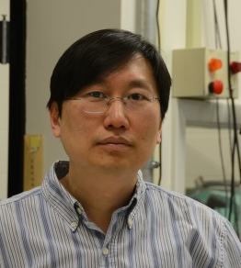
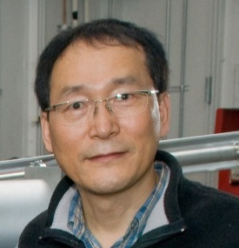
Energy Conversion and Storage Group
Exceptional group of students, postdoctoral fellows and young scientists
The feature of surface electrochemistry
N. Markovic
V. Stamenkovic
D. Strmcnik
P. Paulikas
K-C Chang
H. You
Looking for 3 new Graduate Students

Slide 13


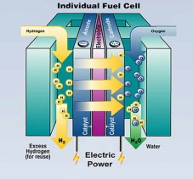
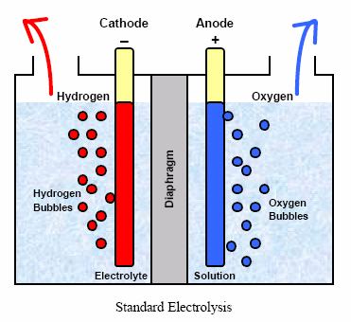
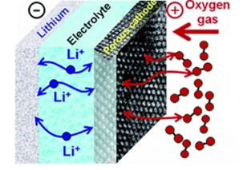
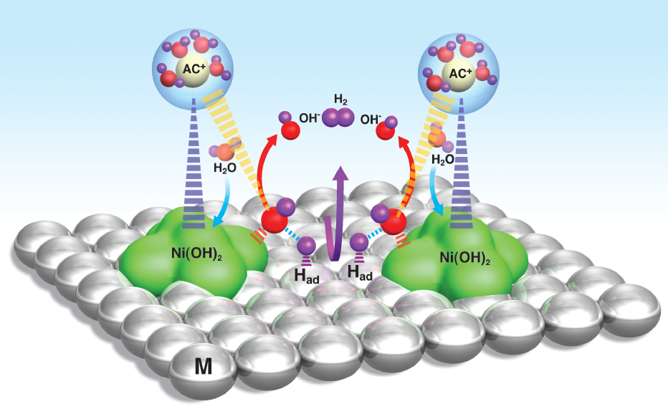
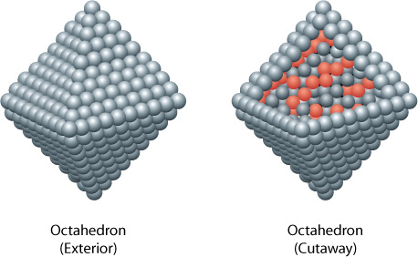
Energy Conversion and Storage Group: N. M. Markovic
Transportation
Vision
Storage
Revolutionize the science and technology of advanced alternative energy conversion and storage systems
Mission
Develop active, stable, selective and cost-effective materials
Fuel Cells
Electrolyzers
Batteries
H₂
O₂
H₂
O₂
C_{x}H_{y}O
C_{x}H_{y}O
Model
Legacies
Commercial
A library of fundamental knowledge
A new paradigm for transformative science
Lifting the wall between water and organic EC systems
2

Slide 14
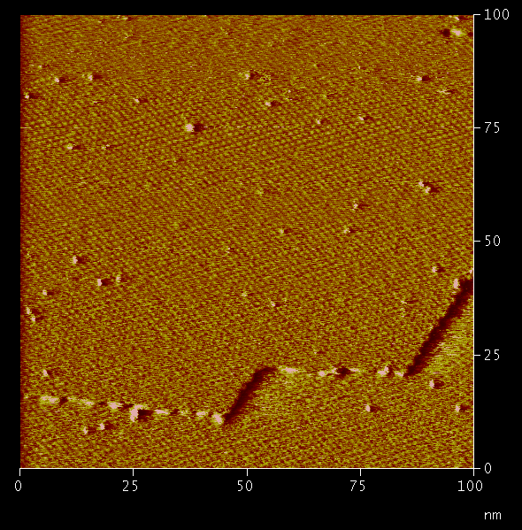
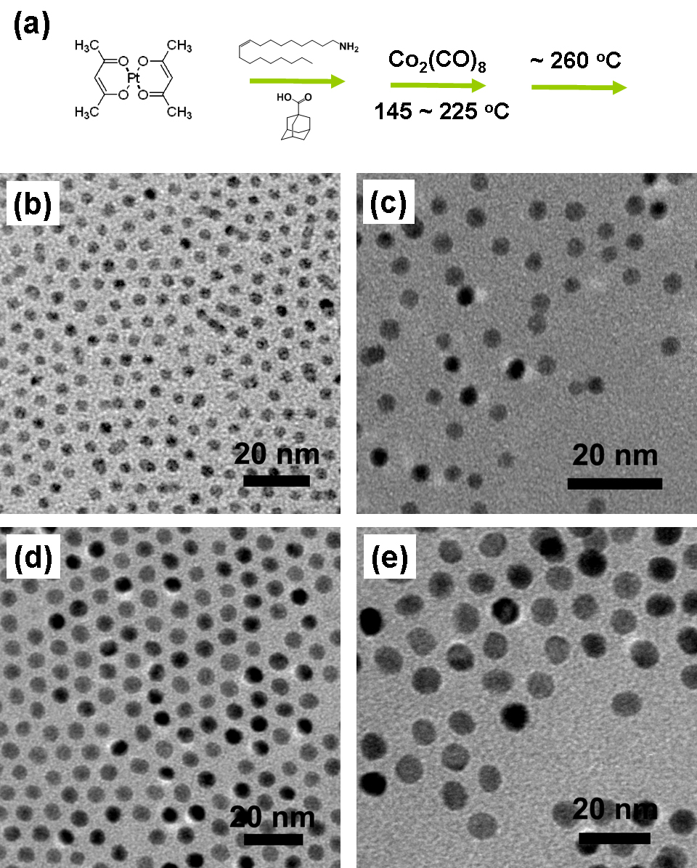
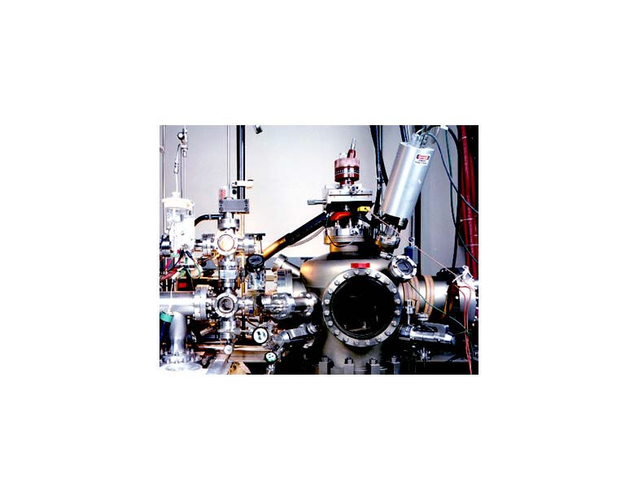
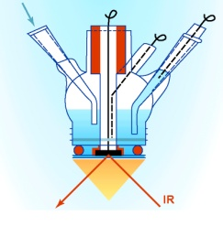
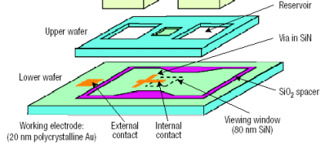
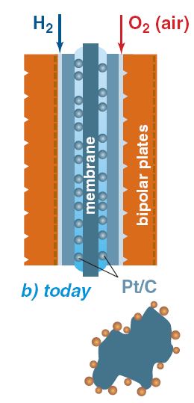
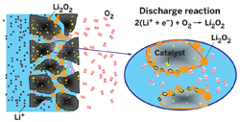
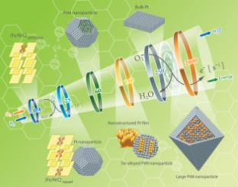
Surface Science Approach
MATERIALS-BY-DESIGN
DOUBLE-LAYER-BY-DESIGN
Single
Model
Real
METALS
ANIONS
Crystals
Nano
Nano
METAL OXIDES
SOLVENT
OXIDES
CATIONS
DESIGN
–– SYNTHESIZE
–– CHARACTERIZE
–– UNDERSTAND
–– APPLY
CHARACTERIZATION METHODS
SYNTHESIS METHODS
UHV
SXRD
FTIR
HRTEM
STM/AFM
RAMAN
CHEMICAL
PHYSICAL
ACTIVITY, SELECTIVITY AND STABILITY MAPPING
REAL SYSTEM
CsOH
Pt
LiOH
KOH
Au
Pt
Ru
Experiment
Theory/Modeling
Batteries
Fuel Cell ↔ Electrolyzer
3

Slide 15
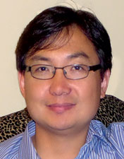

Interfacial Processes Group
Chemical Sciences and Engineering Division, Argonne National Laboratory
Research Staff:
Paul Fenter
Senior Physicist,
Group Leader
Sang Soo Lee
Geochemist
Tim Fister
Physicist
Post-Doctoral Fellows:
Ke Yuan (Geochemist), Jonnathan Medina-Ramos (Electrochemist), Soojeong Kim (Chemist)
Jae Jin Kim (Materials Scientist), Zhenxing Feng (Materials Scientist),
Graduate Students:
Xiao Chen (Applied Physics, Northwestern University)
Erika Callagon (Earth and Environmental Sciences, University of Illinois, Chicago)

Slide 16
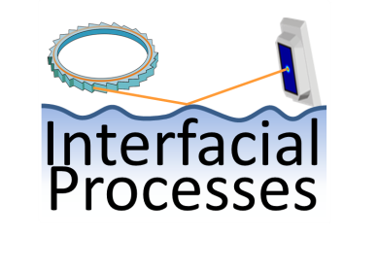
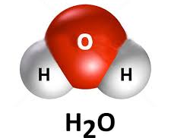
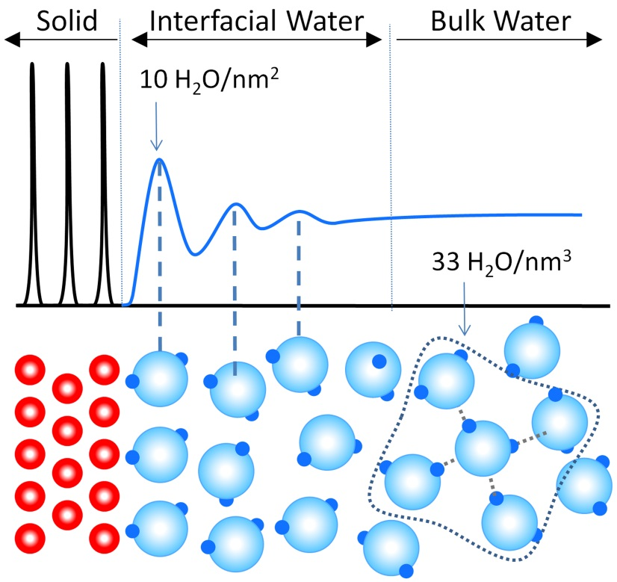
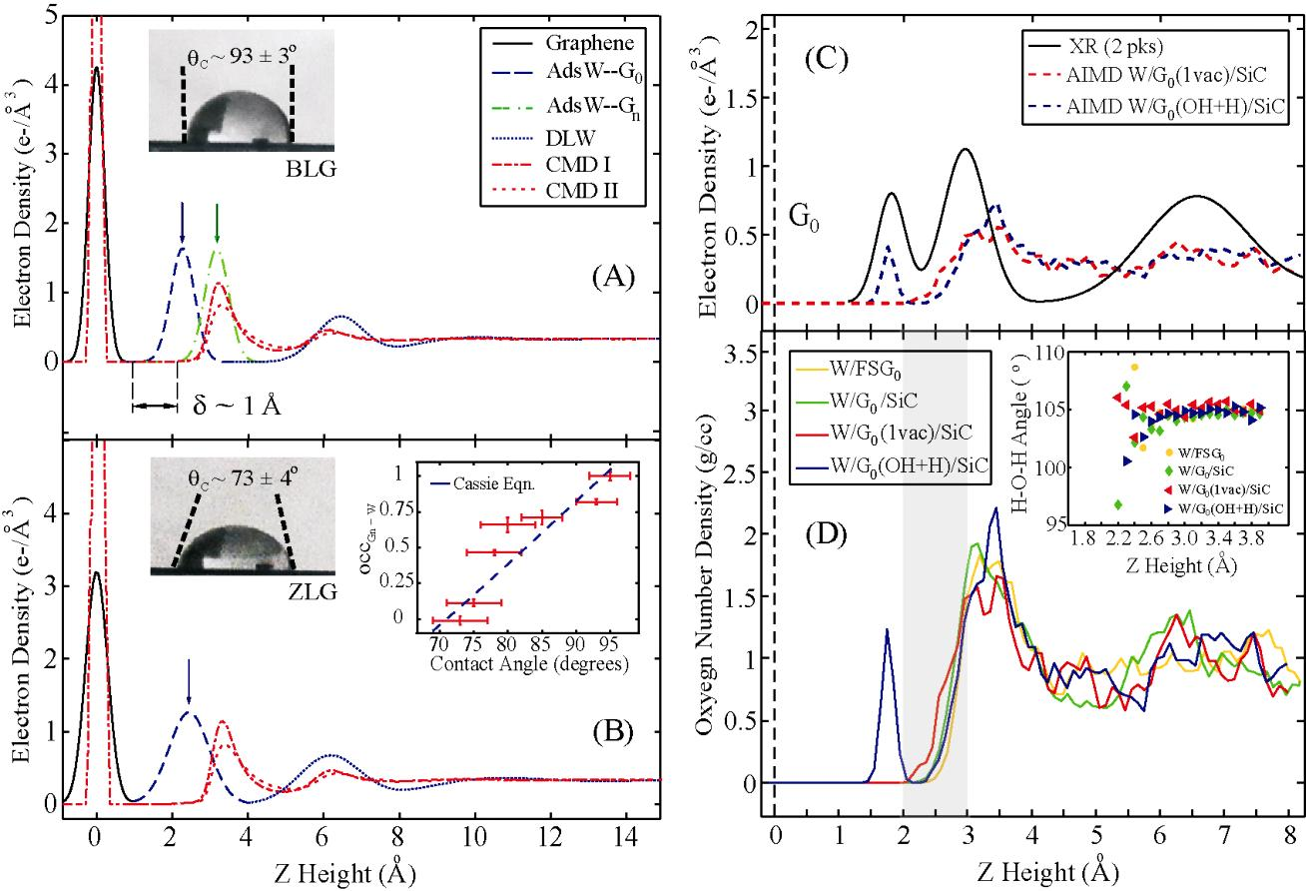
Understanding Water-Solid Interactions: P. Fenter
Background: The interaction of water with solid surfaces is central to a wide range of systems and processes
- Corrosion, electrochemistry, ion separations, catalysis, biofouling, water purification.
Water is a very unusual material due to its hydrogen bonding network
- e.g., with a solid phase that is lower in density w/r to the liquid.
Interfacial reactivity and wetting are controlled by interfacial hydration layers that are defined by the water hydrogen bonding (e.g., water-water vs. water-solid interactions).
Interfacial Water at Solid Surfaces*:
Water contact angles (graphene/SiC)**:
ZLG: “zero layer graphene; the epitaxial buffer layer
BLG: “bilayer graphene”
**Zhou et al., Phys. Rev. B 85 035406 (2012)
*Fenter and Lee, MRS Bulletin, December 2014.

Slide 17
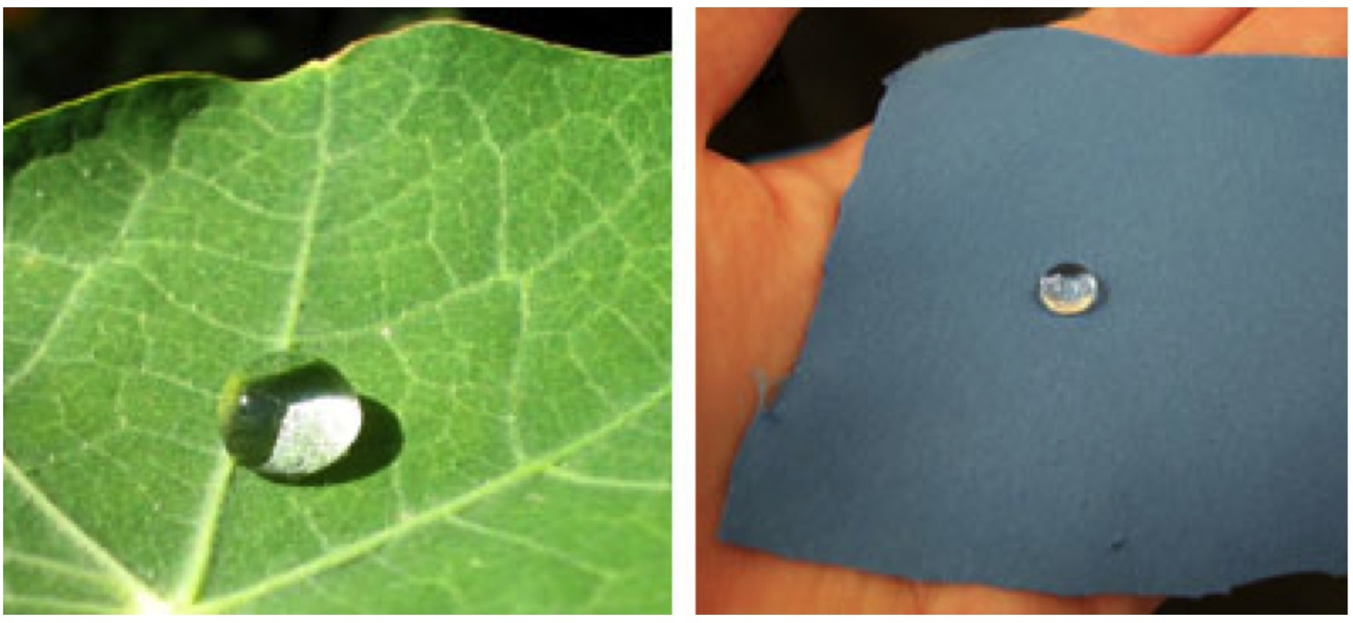
Super-Hydrophobic
Lotus leaf
NanoTex cloth
stain resistant clothing

Slide 18
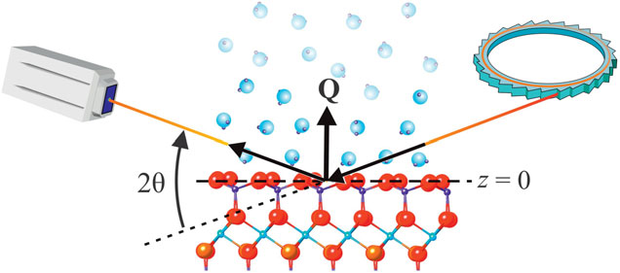
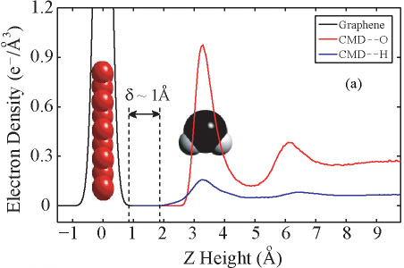
Understanding Water-Solid Interactions: P. Fenter
Goal: Developing a robust molecular-scale understanding the water organization at the solid-water interface.
X-ray reflectivity at the water-solid interface:
Guiding Questions:
How does water organize at interfaces?
vertical and lateral water organization.
direct visualization of hydrogen bonding network.
Can we independently test and validate the experimentally determined structures with high level computations
- Coordinated studies with parallel density functional theory via the MICCoM Center*
X-ray
Example: vertical water structure at graphene:
**Midwest Integrated Center for Computational Materials

Slide 19
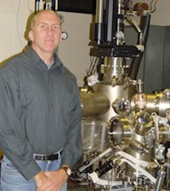
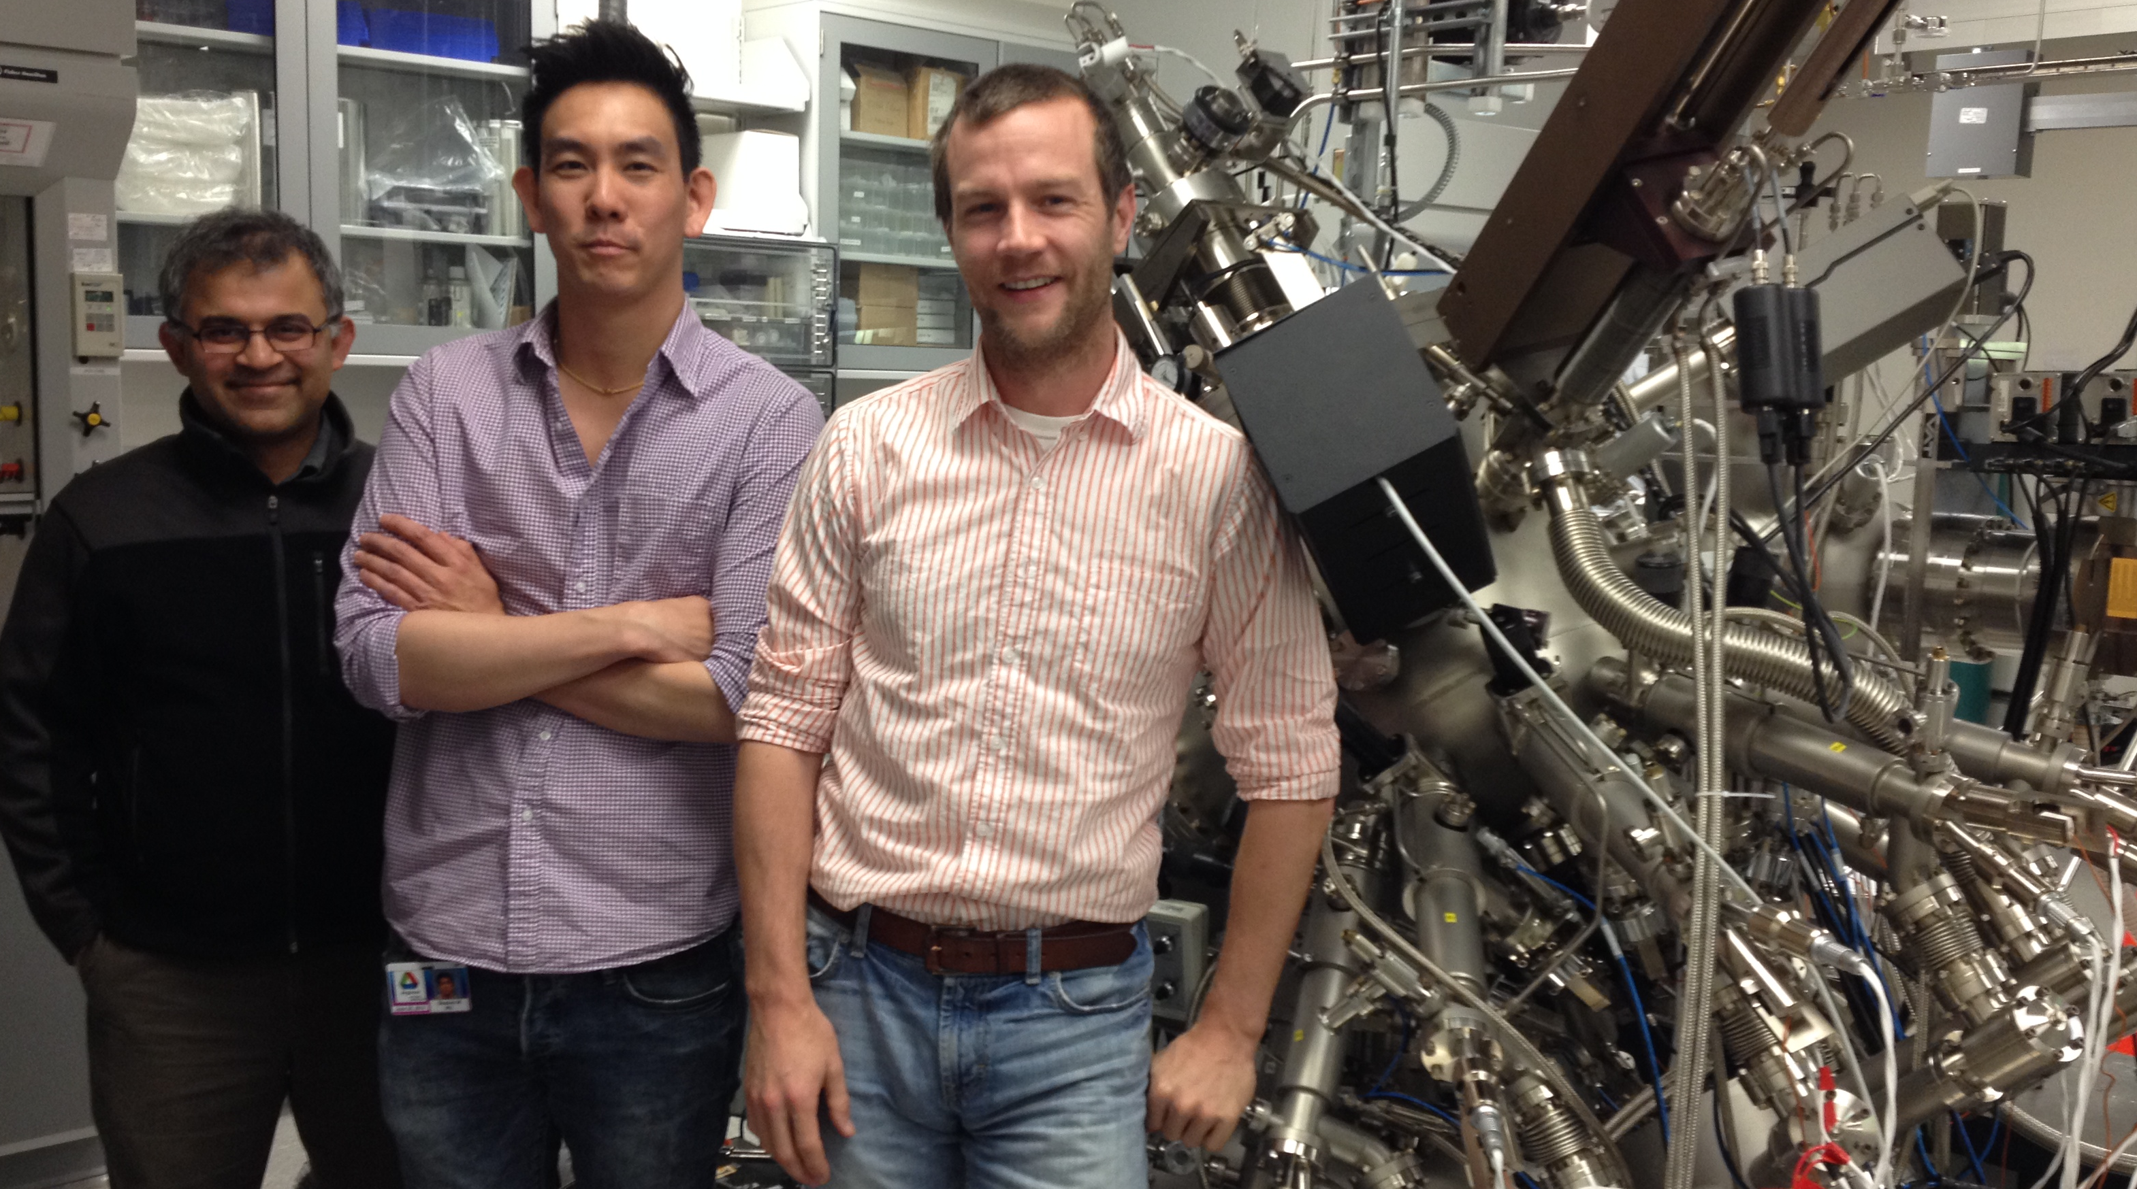
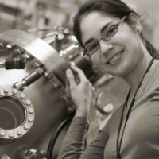
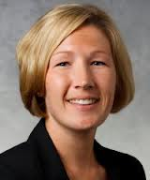
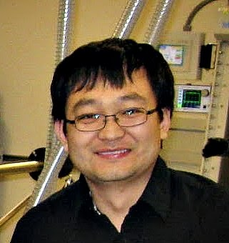
Digital Synthesis: tailoring novel properties in complex oxides
Anand Bhattacharya, anand@anl.gov
John Pearson
(Sr. Engineer)
Stephen Wu (postdoc), Jason Hoffman (recent postdoc, @ Harvard), Anand Bhattacharya (PI)
Postdoc Alumni
Prof. Steve May,
MSE Drexel U., PA
Dr. Tiffany Santos,
Staff, HGST, CA
Prof. Brittany Nelson-Cheeseman, U. St. Thomas, MN
Prof. Ming Liu,
Xian Jiaotong U., China
Notes:
Our current team consists of postdoc Stephen Wu, Sr. engineer John Pearson and PI Anand Bhattacharya. Jason Hoffman, a recent postdoc, has moved on to Harvard as a research associate. We have had postdocs go through our program since 2007 – starting with Steve may who is now faculty at Drexel, Tiffany Santos who is now a Staff Scientist at HGST San Jose, Brittany Nelson Cheeseman who is now faculty at U. St. Thomas and Ming Liu, who joined the faculty at Xian Jiaotong University as part of the 1000 talents program.

Slide 20
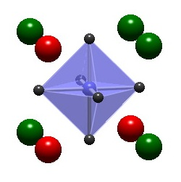
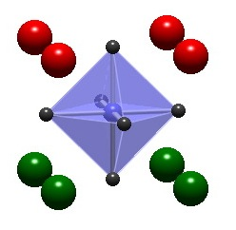
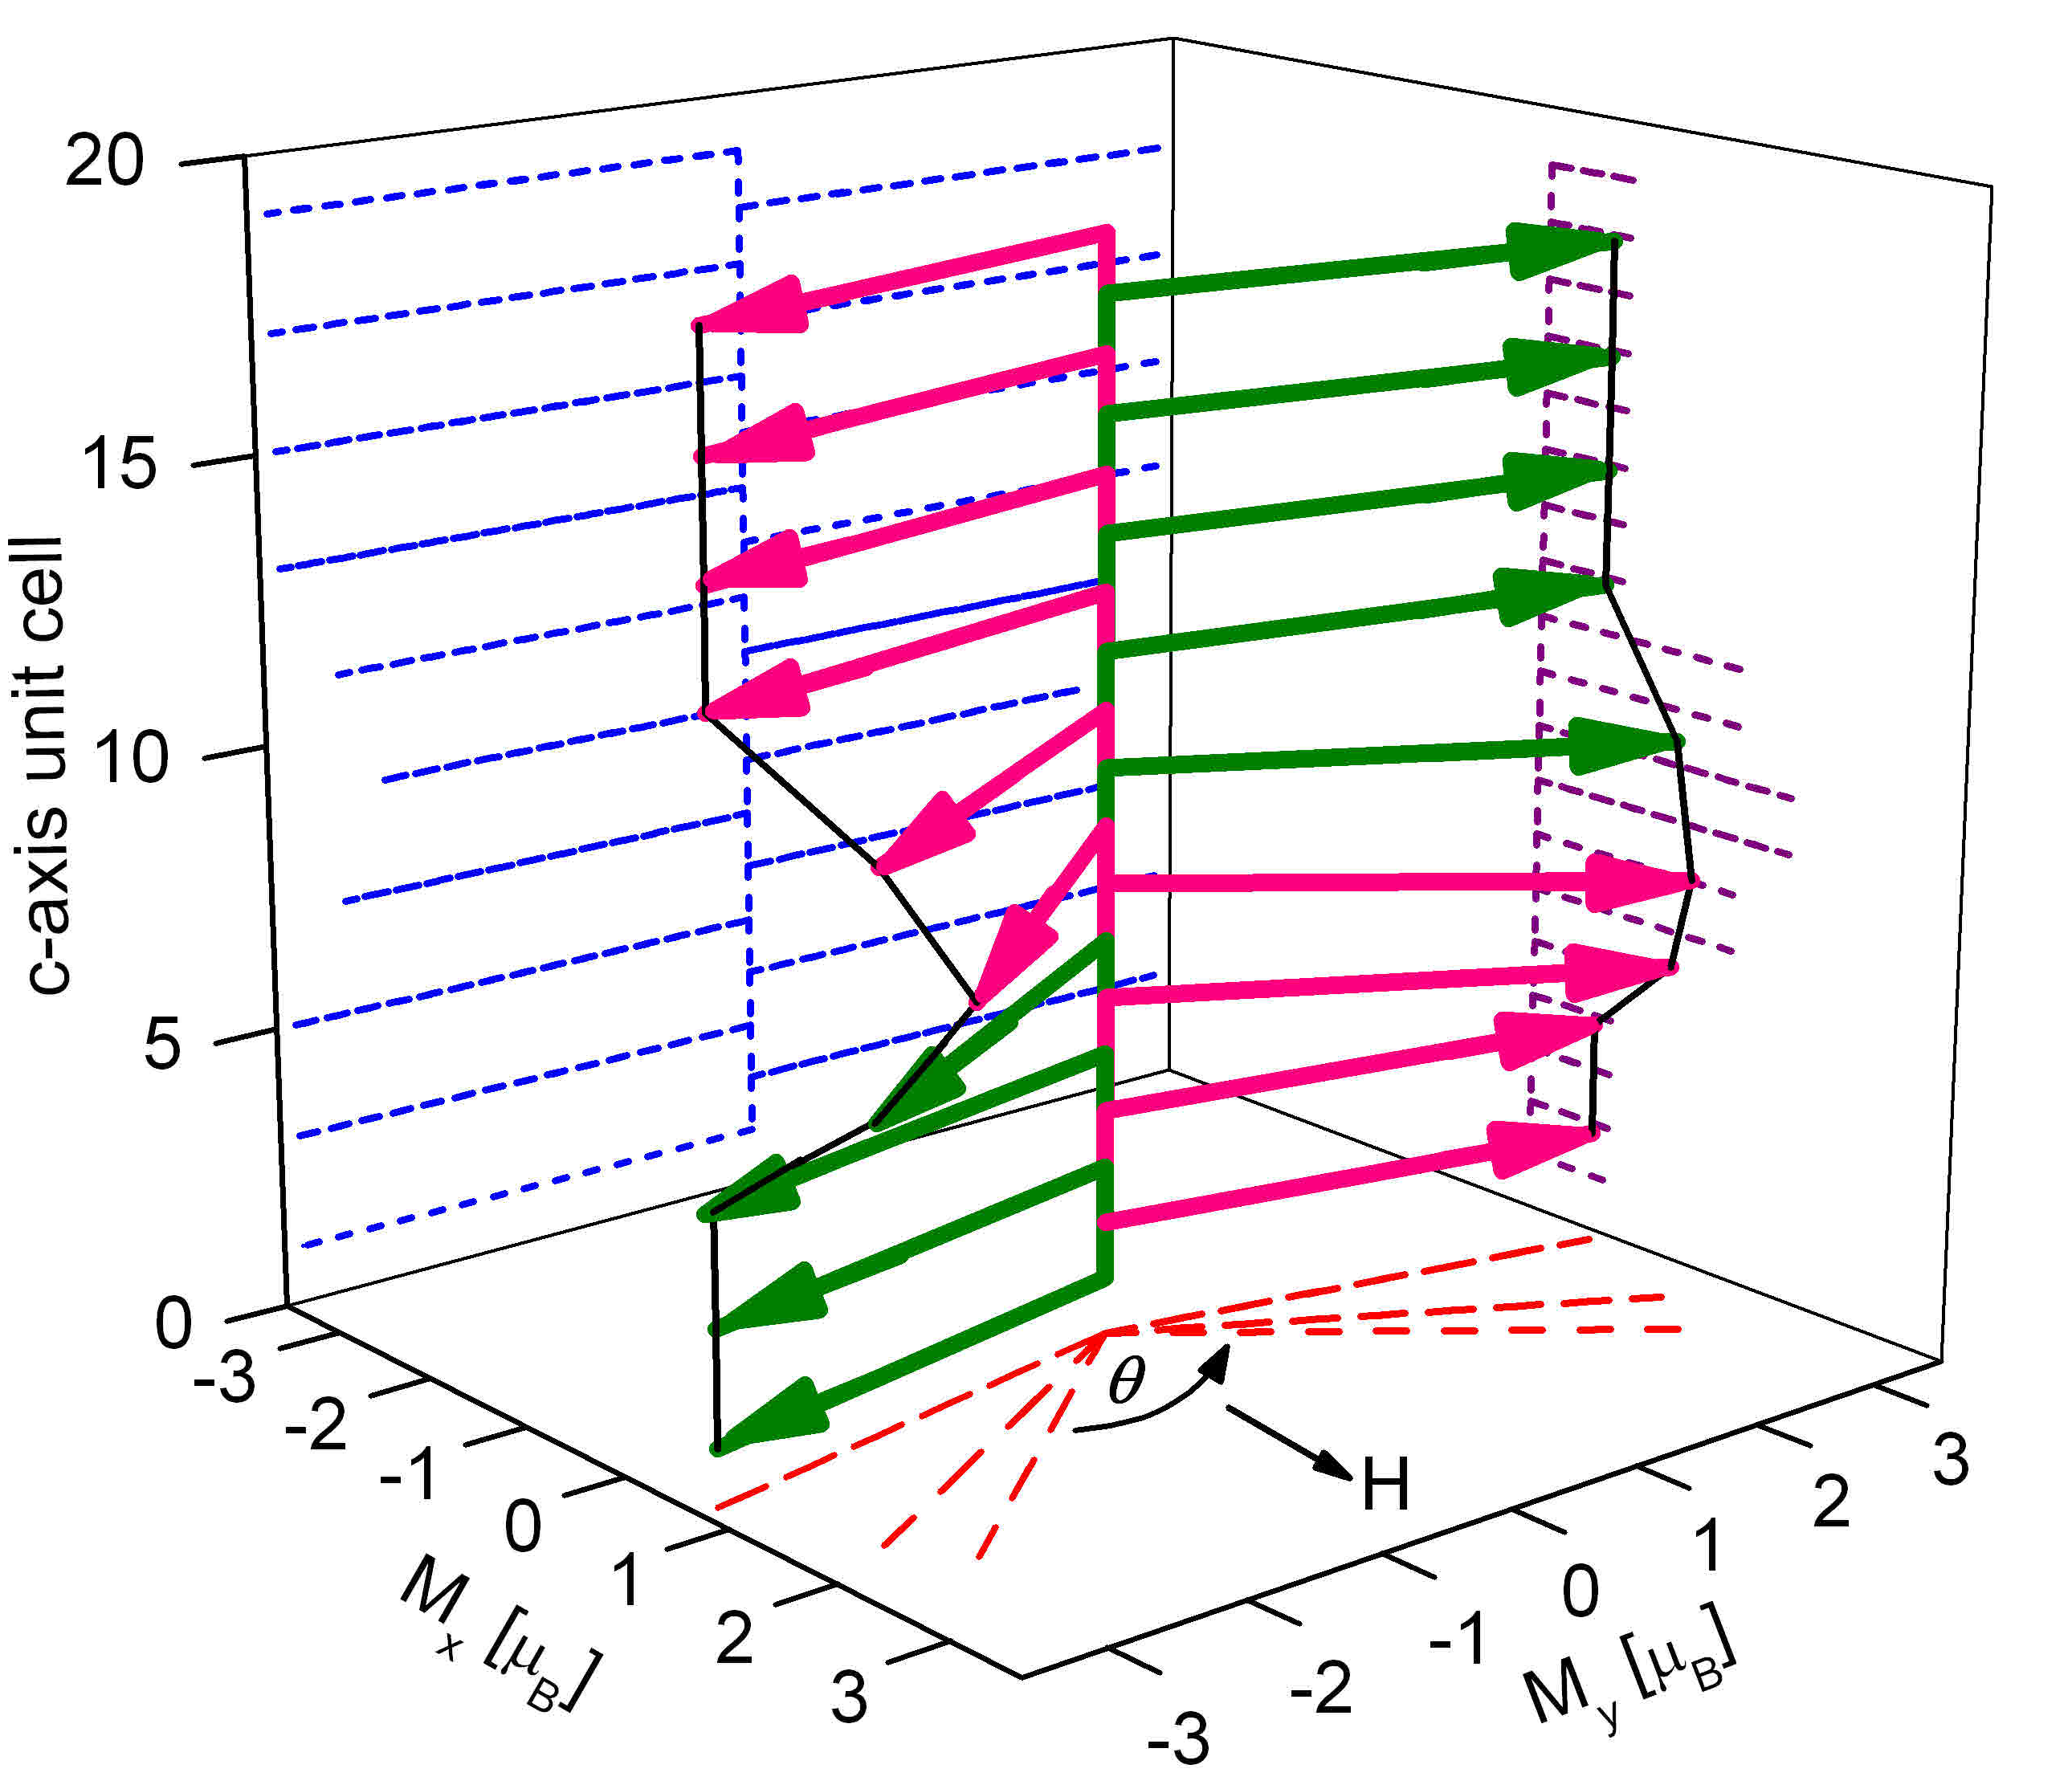
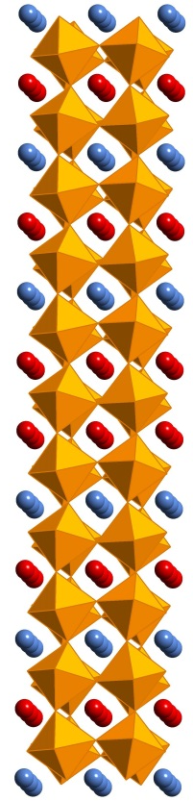

Digital Synthesis: tailoring novel properties in complex oxides
Anand Bhattacharya, anand@anl.gov
Conceive
Discover
Synthesize
What is the role of cation disorder?
Explore
LaMnO₃/SrMnO₃
Create model materials systems with oxide-MBE
Canted magnetic state
PRL 107, 167202 (2011).
Magnetic structure; T_{N} increases by 70 K
Nat. Mater. 8, 892 (2009).
Notes:
The complex oxides are some of the most promising and interesting materials for energy. Digital Synthesis is a way to tailor complex oxides with new and novel properties. So how does this work? In our program, the conception of a new ‘digital oxide’ begins with asking a simple question. For example, we have asked - what is the role of disorder in the properties of manganites? We can address this by synthesizing a model system like the one in this figure, with single unit cell precision. Next, we explore the structure and properties of this material. With the amazing tools available to us now, we can in fact find out where all the atoms are in our sample, what the bonds between them are doing, and how their spins are arranged. This, coupled with other measurements leads to new insights and discovery of novel properties. For example, we have shown that manganite superlattices made this way can have record high Neel temperatures. In the last review period, we realized a canted magnetic state that was predicted by deGennes in his seminal paper, and pointed out as one of the outstanding quests in the field of manganites in Elbio Dagotto’s book on the subject. This process repeats as we refine our questions and improve our understanding of these materials, and our ability to design new properties.

Slide 21
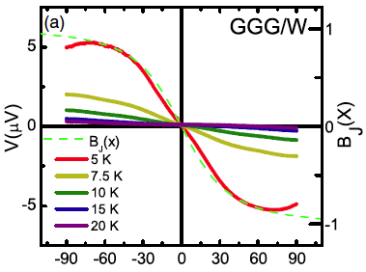

Recent Highlight: Discovery of Paramagnetic Spin Seebeck Effect
Paramagnetic Spin Seebeck Effect, S. Wu, J. Pearson, A. Bhattacharya, Phys. Rev. Lett. 114, 186602 (2015) (Editor’s Suggestion);
Also first observation of Antiferromagnetic SSE (arXive 2015)
Notes:
Notes: When a thermal gradient is applied across a ferromagnetic material, it can drive a spin current via the spin Seebeck effect. A few years ago, it was shown that this effect also works in ferromagnetic insulators where the charge degree of freedom is strongly gapped. Here, a ‘pure’ spin current results from a thermal imbalance in the population of magnons. In this work, we have shown that the spin Seebeck effect can also occur in paramagnetic insulators that nominally do not support magnons.
The result is surprising and also encouraging as it broadens the class of materials that may be used to generate spin currents, particularly at low temperatures. For example, in geometrically frustrated pyrochlore magnets that host spin ice and spin liquid ground states, the excitations can be quire unusual – such as magnetic monopoles and spinons. Coupling to these excitations and moving them around remains a challenge. Our results imply that we may be able create spin currents from these excitations using local thermal gradients, and detect them via the inverse spin Hall effect.
The technique to carry out this measurement was developed at Argonne (work published by the same team in APL and JAP in the past year), where a patterned Au wire about 10 microns wide was used to deliver the heat locally to the surface of the paramagnet. This results in a large out-of-plane thermal gradient near the surface that drives a spin current out of the underlying paramagnet. The spin current is detected using the inverse spin Hall effect in W or Pt layers on the surface of the paramagnet. The signal is quite large and comparable to what is observed in the more conventional YIG/Pt structures. Note that the Au heater wire and the detector layer are electrically isolated from each other.

Slide 22

Recent Highlight: Tailoring bond lengths with electrostatics
“Polar cation ordering: A route to introducing > 10% bond strain into layered oxide films”, B. B. Nelson-Cheeseman, H. Zhou, P. V. Balachandran, G. Fabbris, J. Hoffman, D. Haskel, J. M. Rondinelli, A. Bhattacharya, Advanced Functional Materials 24 (2014)
Notes:
By using a layer by layer synthesis approach, we are able to tailor artificial dipoles within a material. Here, this is done by layering LaO (+1), NiO2 (-1) and SrO (0) in a manner that produces a dipole within each formula unit of LaSrNiO4. This makes LaSrNiO4 a ‘polar’ metal. We observe a distortion of the NiO bond lengths along the c-xis (vertical direction on this slide) that are a resukt of the crsytal trying to compensate for the dipole that we have artificially introduced. This is a new approach to tailor bond lengths and thus the elctronic and magnetic properties of oxides.

Slide 23
Argonne collaborative projects
looking for 5 new grad students
3 with Nenad Markovic, MSD, JCESR
Electrode/Electrolyte Interface Structure & Properties
www.msd.anl.gov/markovic
1 with Paul Fenter, CSE
Water-Solid Interactions
www.msd.anl.gov/fenter
1 with Anand Bhattacharya, MSD & CNM
Digital Synthesis: Tailoring novel properties in complex oxides
www.msd.anl.gov/bhattacharya
M. Bedzyk will arrange meetings both at NU and at ANL

